Slide 1
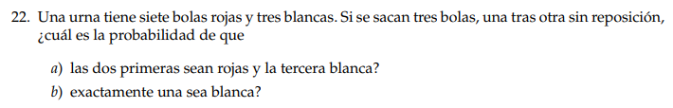



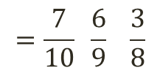


“Se extraen 3 bolas”
Sin reposición
$$a)$$
$$P\left(R_{1}{∩R}_{2}∩B_{3}\right)$$
$=P\left(R_{1}\right). P\left(R_{2}/R_{1}\right)$ . $P\left(B_{3}/R_{1}{∩R}_{2}\right)$
$$=\frac{7}{10} \frac{6}{9} \frac{3}{8}$$
1°
2°
3°
“En este orden”
$$P\left(R_{1}{∩R}_{2}∩B_{3}\right)$$
$$=\frac{7}{40}$$

Slide 2






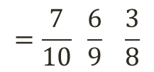
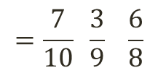

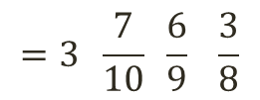



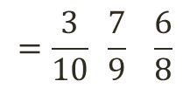
“Se extraen 3 bolas”
Sin reposición
$$b)$$
$$=\frac{7}{10} \frac{6}{9} \frac{3}{8}$$
$$P\left(R_{1}{∩R}_{2}∩B_{3}\right)$$
$=P\left(R_{1}\right). P\left(R_{2}/R_{1}\right)$ . $P\left(B_{3}/R_{1}{∩R}_{2}\right)$
$$P\left(R_{1}{∩B}_{2}∩R_{3}\right)$$
$=P\left(R_{1}\right). P\left(B_{2}/R_{1}\right)$ . $P\left(R_{3}/R_{1}{∩B}_{2}\right)$
$$=\frac{7}{10} \frac{3}{9} \frac{6}{8}$$
$$P\left(B_{1}{∩R}_{2}∩R_{3}\right)$$
$=P\left(B_{1}\right). P\left(R_{2}/B_{1}\right)$ . $P\left(R_{3}/B_{1}{∩R}_{2}\right)$
$$=\frac{3}{10} \frac{7}{9} \frac{6}{8}$$
$$P\left(R∩R∩B\right)$$
$$=3 \frac{7}{10} \frac{6}{9} \frac{3}{8}$$
$$P\left(R∩R∩B\right)$$
$$=\frac{21}{40}$$

